Slide 1
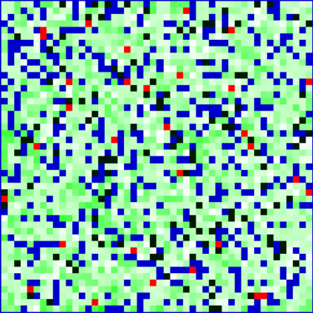
PLANISUSS
A SIMULATION BY:
- FILIPPO BENCIVENNI
- ROBERTO TORCHIARELLA

Slide 2
PLANISUSS
With Planisuss, our aim was to simulate a simplified ecosystem, envisioning a world that could sustain itself for an extended period without collapsing. Our primary goal was to create a visually appealing and well-coded simulation that brought our ideas to life. We successfully developed a simulation that met our expectations. The simulation embodies a delicate balance, ensuring its self-maintenance over an extended period.

Slide 3
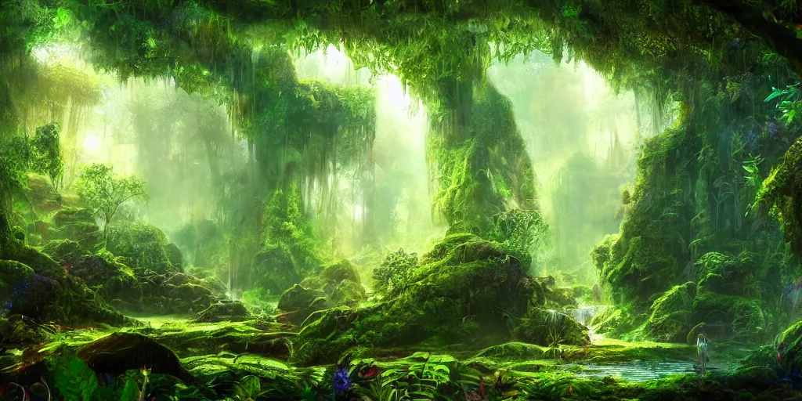
THE WORLD

Slide 4
THE WORLD
Our world is organized into a square matrix, where each cell serves as a miniature parcel of land. Within this matrix, cells are distinguished by their unique positions, types ('Water' or 'Ground'), and references to the larger grid.
Specifically, 'Ground' cells boast additional attributes. The 'vegetob' parameter tracks the quantity of vegetation within each 'Ground' cell. Additionally, there's an 'inhabitants' set, capturing the array of animals residing in that particular cell. Delving deeper, 'Ground' cells feature more specialized lists, namely 'herds' and 'prides,' which meticulously monitor the presence of distinct animal groups.
In our simulation, the grid is a mix of white and blue cells. White represents the ground and blue indicates water. The gradual growth of vegetation is visually represented by the transformation of ground cells to green. Animal presence is represented by red and dark green cells. This visual simplicity not only enhances the simulation's aesthetics but also makes it more accessible for observers to understand the dynamics of our simulated world.

Slide 5
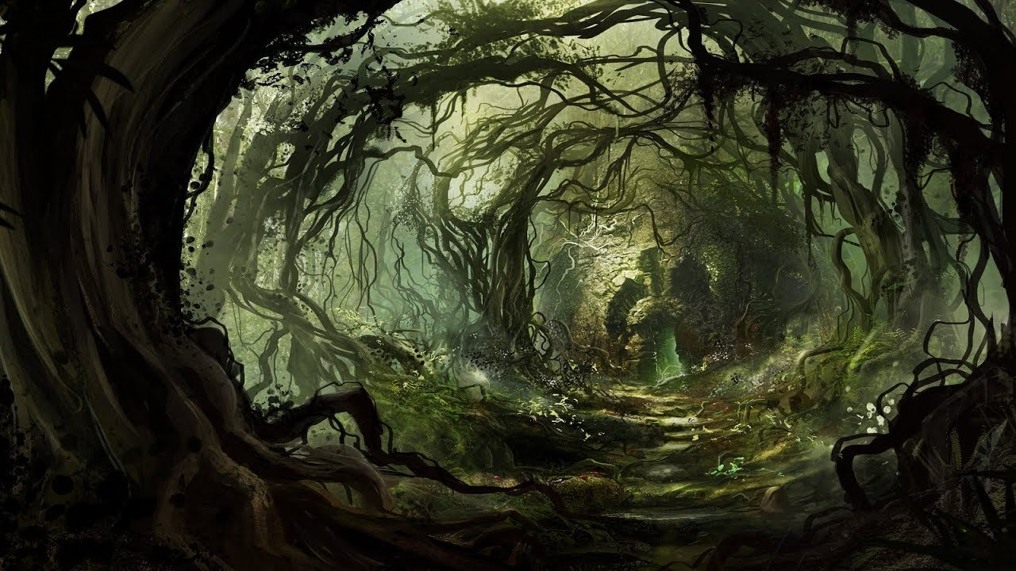
VEGETOB

Slide 6
VEGETOB
In the world of Planisuss, Vegetobs are not your ordinary, innocuous plants. They may seem simple, but they carry significant weight in our simulated ecosystem. Each Vegetob comes with a density attribute, a gauge of its presence within a cell. The twist comes when a Vegetob hits maximum density – it turns into a potential threat, capable of endangering animals trapped in a cell surrounded by Vegetobs at their peak. Vegetobs grow slowly day by day. However, they can't grow on water and can only infest ground cells.
Their importance is also evident in their role as the primary sustenance for the Erbast. These creatures rely on grazing on Vegetobs to stay alive.

Slide 7
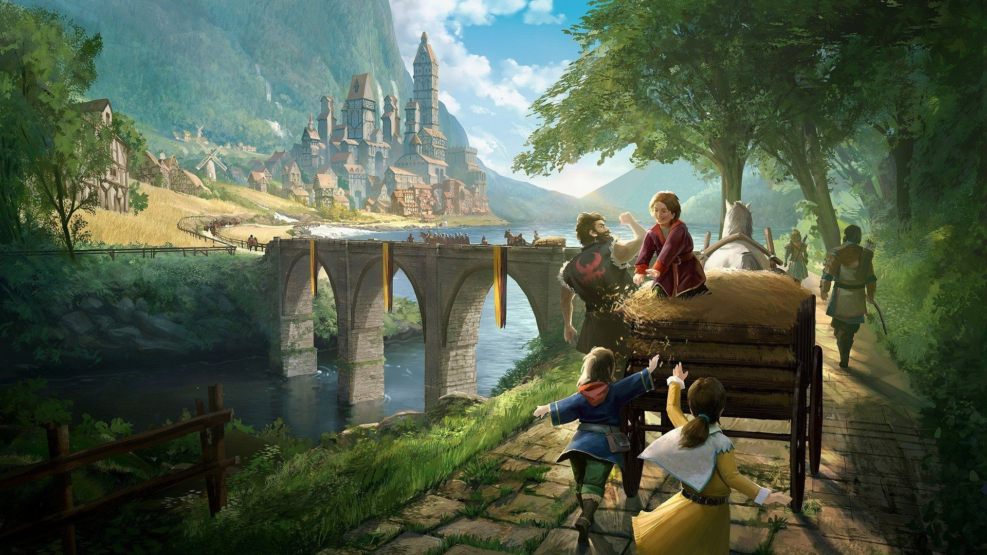
INHABITANTS

Slide 8
INHABITANTS
In our simulated world, two primary inhabitants take center stage: Carviz and Erbast. Both fall under the Animal class and share a set of essential attributes. These attributes play pivotal roles in shaping the behavior and characteristics of these creatures.
The 'lifetime' attribute, for instance, sets an initial life expectancy for each animal upon spawning, providing a baseline for their existence. Crucially, when an animal reaches the end of its lifetime, it spawns two offspring that inherit its attributes. The 'socialAttitude' attribute comes into play as a determinant of an animal's likelihood to align with group decisions. 'Energy' serves as a central attribute, influencing movement decisions and even dictating the life or death of an animal. 'Moved' keeps tabs on an animal's movement decisions for a given day, offering insights into their daily activities and patterns. Meanwhile, 'cell' stands out as a key attribute, serving as a crucial locator that tracks the position of each animal within the grid.
These attributes collectively form the backbone of our inhabitants' characteristics, influencing their lifespan, social interactions, energy dynamics, and spatial presence within the simulated ecosystem of our world.

Slide 9
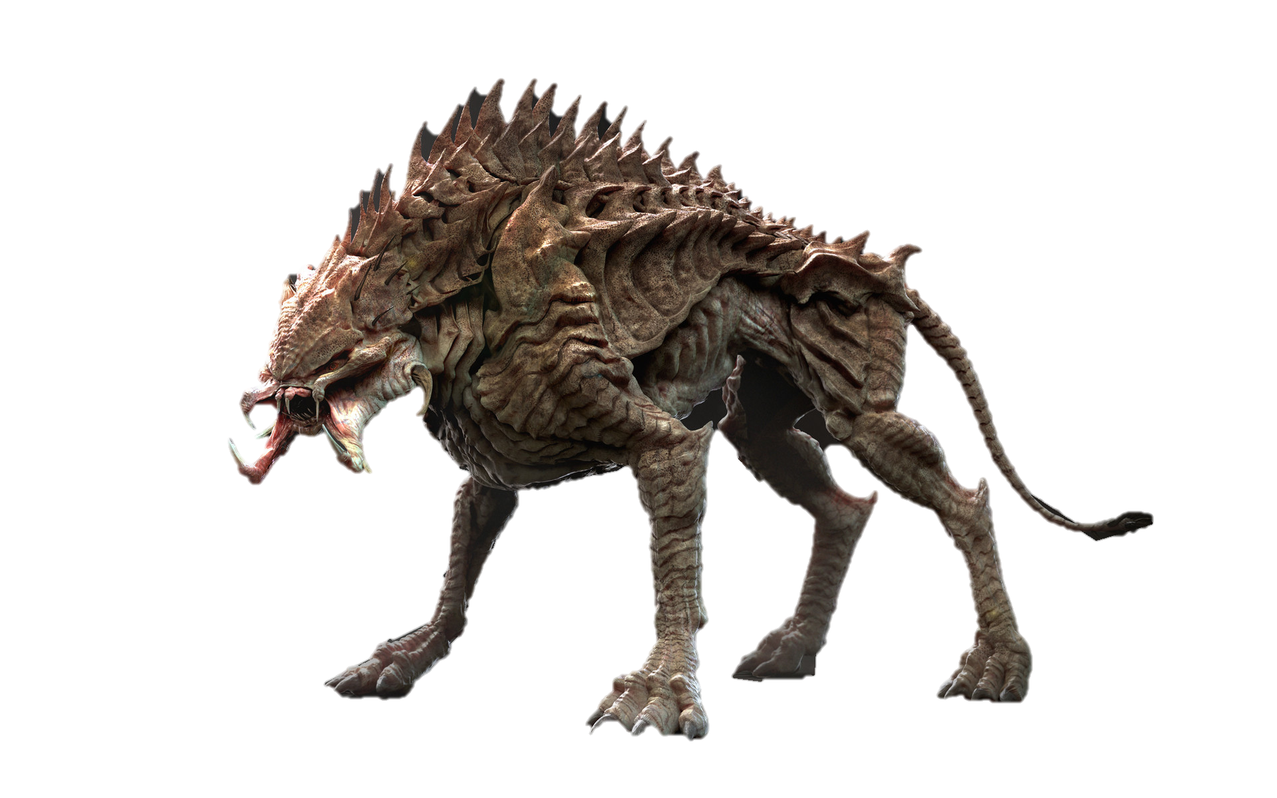
CARVIZ

Slide 10
CARVIZ
Carvizes take on the role of predators in our simulated world, actively hunting Erbasts and consuming their energy for survival. These creatures are characterized as solitary and aggressive, often forming small prides with other Carvizes.
Constantly in motion, Carvizes tirelessly search for prey to sustain themselves. While they possess a high energy level, it depletes rapidly in the absence of Erbasts to hunt.
Due to their long-life expectancy, Carvizes face limitations in reproduction. Their ability to produce offspring is relatively constrained, adding an element of balance to their role as predators within the ecosystem.

Slide 11
PRIDES
Carvizes, when inclined to socialize, come together to form prides. These prides typically consist of a small number of Carvizes and often develop enduring bonds. The aggressive nature of Carvizes becomes evident when prides from different groups encounter each other, leading to confrontations that persist until only one pride remains standing. The victorious Carvizes experience a notable enhancement in their socialAttitude towards their group, at the cost of limiting their movement for the day.
Prides move collectively towards their prey, strategically targeting the strongest Erbast they can find. To maintain a balance within the pride, there exists a 'max_size' attribute. Offspring exceeding this value are expelled from the pride, ensuring that prides remain manageable and efficient in their hunting strategies.

Slide 12
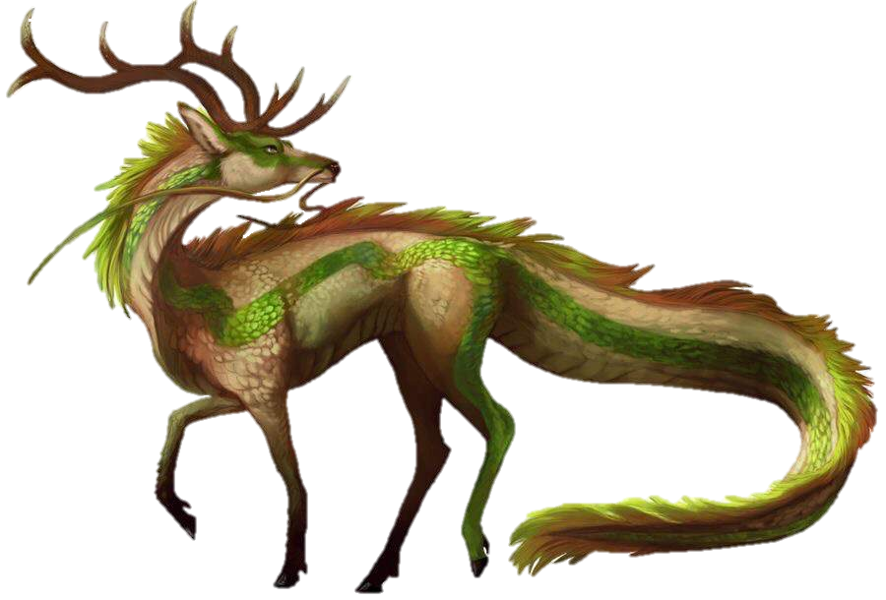
ERBAST

Slide 13
ERBAST
Erbasts, the herbivores of Planisuss, sustain themselves by grazing on Vegetobs to maintain their energy levels. These sociable creatures frequently come together to form herds, although they tend to disperse due to diverging decisions. Erbasts, preferring a more stationary lifestyle, don't move unless necessary, opting to stay in one place and graze on the vegetation in their respective cells. They actively try to avoid Carvizes.
Despite their relatively low lifetime expectancy, Erbasts compensate by reproducing at a rapid rate, contributing to the continual growth of their population even in the face of predation. This reproductive strategy allows them to sustain their numbers, creating a dynamic balance in the ecosystem of Planisuss.

Slide 14
HERDS
Erbasts exhibit a collective behavior, forming herds that can be formed by numerous members but are prone to occasional splits. Their highly social nature permits these herbivores to merge with other groups of Erbasts when they cross paths. Within these herds, each Erbast partakes in a daily decision-making process, weighing the choice to either move or remain stationary. The group's final decision is determined by the majority. However, the individual social attitudes of herd members allow them the flexibility to alter their initial decisions based on the group consensus or persist in their original choices, potentially leading to separations from the herd.
Erbasts can fight back when hunted, with the likelihood of survival tied to the energy level of the animal. Acknowledging the critical role of energy in their survival, Herds exhibit a cooperative strategy, prioritizing individuals with low energy when grazing. This collaborative approach enhances the overall resilience of the herd in the dynamic ecosystem of Planisuss.

